Slide 1
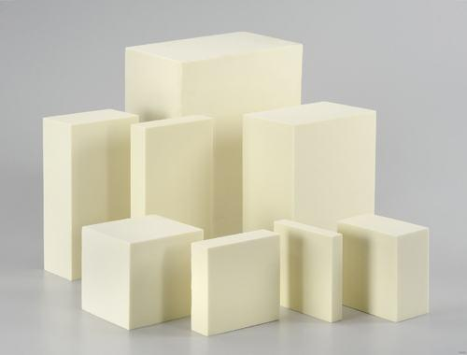
Global Market of Chlorthalidone
Global Techno-Commercial Report

Slide 2
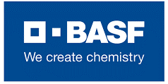
Executive Summary
Global & Indian Chlorthalidone Market 2020-21 in a Nutshell
2020-21
by Volume
10,000t
by Value
~ $62m
Global
Chlorthalidone
Market
by Volume
36mt
by Value
$4.5M
Growth rate
2018-2024
4.7%
Indian
Chlorthalidone
Market
by Volume
10,000t
by Value
~ $62m
by Volume
36mt
by Value
Growth rate
2018-2024
4.7%
Global Chlorthalidone Manufacturers Market share by Geography
Global Chlorthalidone Manufacturers
by Geography
Top 5 Global Manufacturers
Ipca Laboratories
Ltd.
Teva Pharmaceuticals
Industries
Sandos Ltd.
Orion Corp.
Haihang Industry
Co. Ltd.
2020-21
2020-21
Total No. of Buyers of global (Chlorthalidone) is with the buying quantity of 36MT
The report also contains the profile of country wise buyers with their buying quantities & contact details

